Slide 1
Project Proposal: Classifier of natural disasters
Artjoms Musaelans
234535

Slide 2
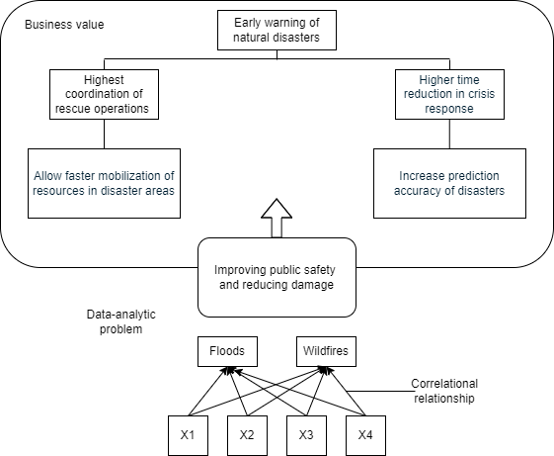
Project Pitch
Business Understanding
The first idea: Application that provides early warning and rapid response capabilities for natural disasters.
Problem based on the market research: Ineffective response to natural disasters
Main stakeholder: Emergency response agencies
Stakeholder's needs:
- Early detection and monitoring
- Integration with existing systems
- Detailed categorization
- Accuracy and reliability

Slide 3
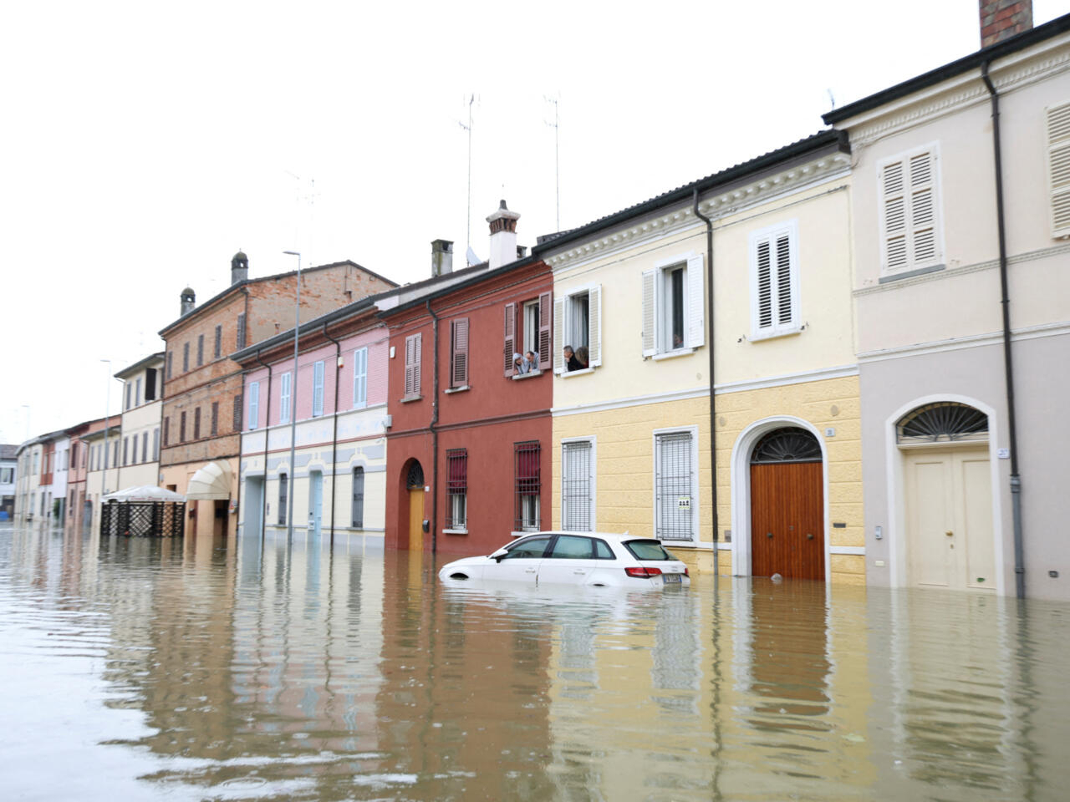
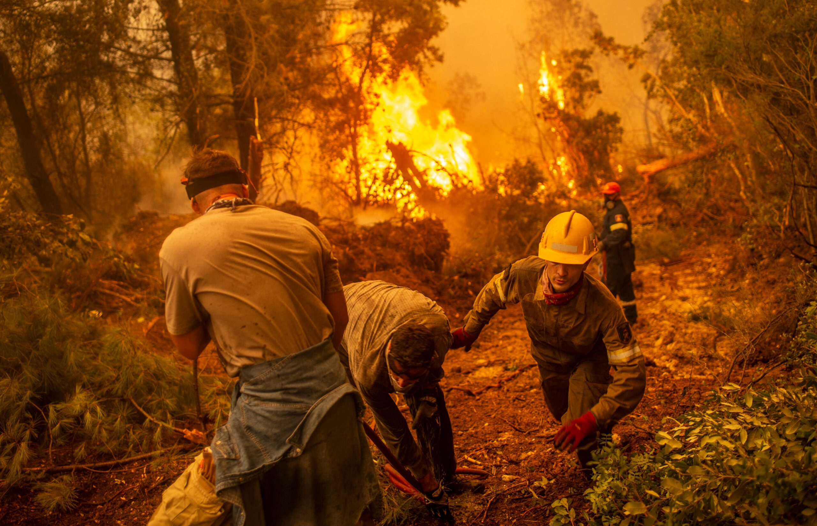
Problem Overview
Deep Learning
The model will classify natural disasters
Model predicts 2 classes: Floods ; wildfires.
150 images per class
Random Guess Accuracy: 50.0
Human-Level Performance Accuracy: 98.33%
Basic Multilayer Perceptron Accuracy:
Test Loss: 0.4833648204803467
Test Accuracy: 0.8125

Slide 4
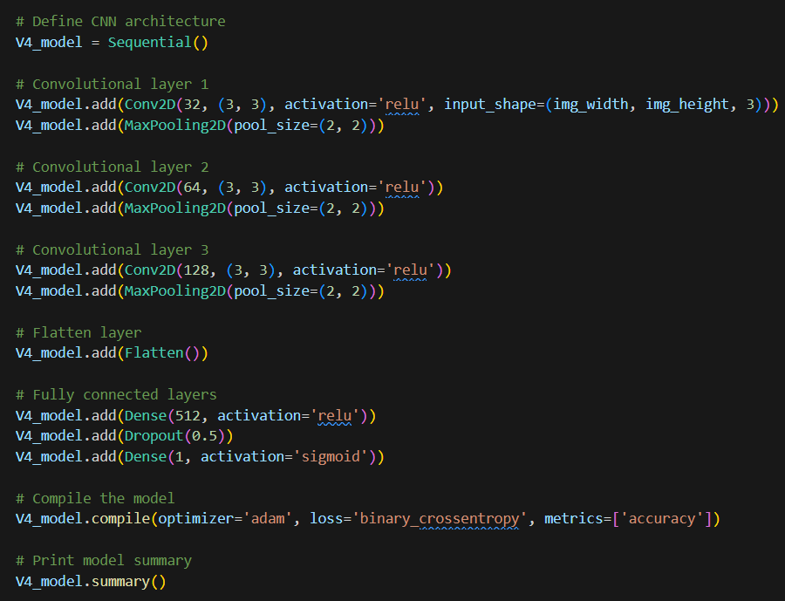
Model Overview
Deep Learning
Data Preparation: Resized and normalized images for uniformity.
Iteration 1: Basic CNN for initial performance metrics.
Iteration 2: Added advanced data augmentation.
Iteration 3: Enhanced architecture with more layers.
Iteration 4: Fine-tuned model with early stopping.
Final Architecture: Convolutional layers with dropout and batch normalization.

Slide 5
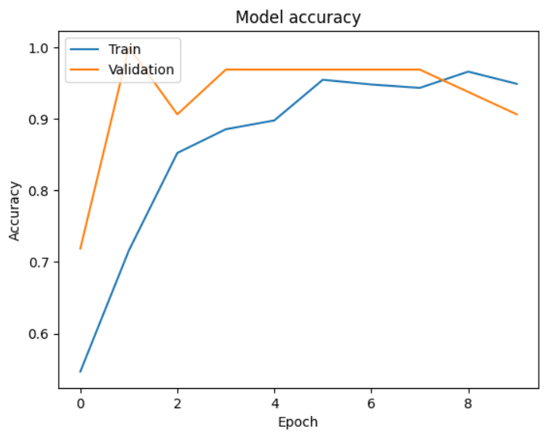
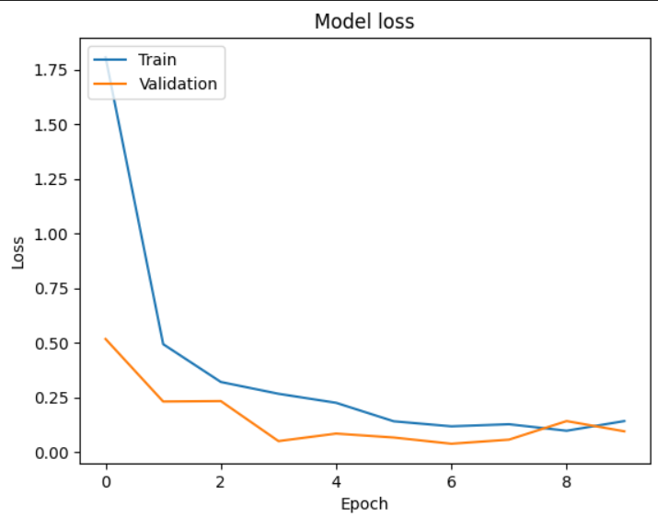
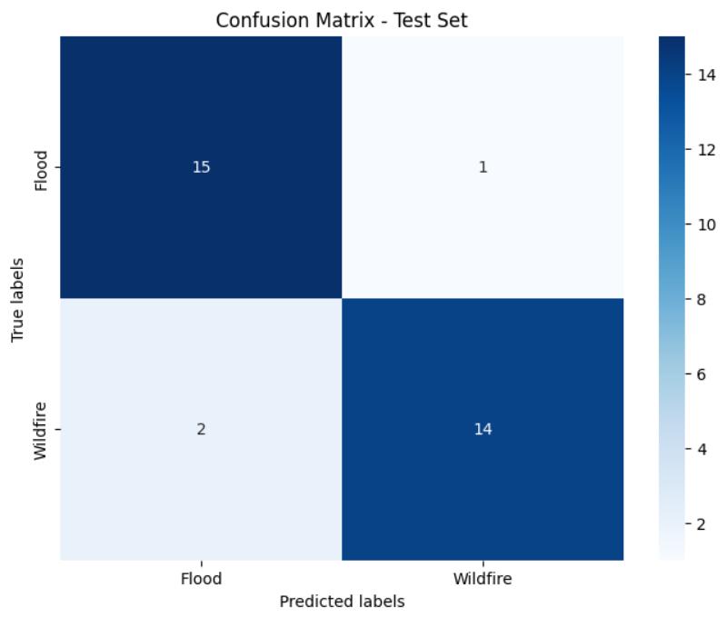
Model Performance
Deep Learning
After 10 epochs of training, the result was as follows:
Training performance:
Loss: 0.1421
Accuracy: 0.9489
Validation performance:
Validation loss: 0.0952
Validation accuracy: 0.9062
Test performance
Test Loss: 0.2572921812534332
Test Accuracy: 0.90625

Slide 6
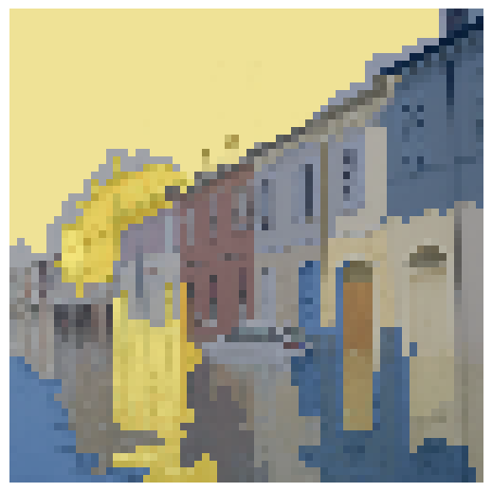
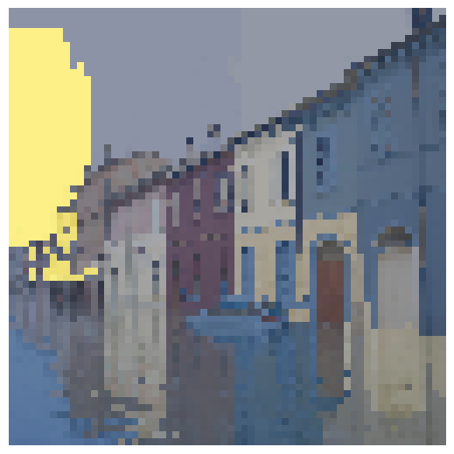
Model Interpretability
Responsible AI
Discuss the trade-off between accuracy and interpretability:
In my application, the classification of natural disaster images, there's a critical balance between achieving high accuracy and ensuring interpretability. While accuracy is essential for making reliable predictions, interpretability allows us to understand why certain predictions are made, which is vital for building trust in the model's decisions. such as Grad-CAM, LIME and KernelShap
What underlying pattern(s) does the model identify:
My model identifies various patterns indicative of different types of natural disasters, such as floods or wildfires. To ensure interpretability, I applied Explainable AI methods, such as Grad-CAM and LIME . These techniques allow us to peek into the "black box" of deep learning models and understand how they arrive at their decisions.
For instance, by employing techniques like Grad-CAM I can visualize which parts of an image contribute most to the model’s prediction. This provides valuable insights into how the model recognizes specific objects, textures, or shapes associated with different types of disasters.

Slide 7
User Study
Human-Centered AI
A/B Test Plan
I conducted an A/B test to evaluate design enhancements on user engagement and satisfaction.
Versions tested:
Version A (Baseline): Initial wireframe.
Version B (Improved): Improved wireframe with additional pages, new visuals and animations.
Hypothesis: Because version B has new pages, fresh graphics, animations, and features, users interacting with it will be considerably more satisfied and engaged than version A.
Results:
Understanding the application (Q1): T-test: T(statistic=-3.58, p=0.002) Interpretation: Significant difference in comprehension. Version B is clearer with more pages and contextual instructions.
Intuitiveness of use (Q2): T-test: T(statistic=-8.08, p<0.00001) Interpretation: Significant improvement in intuitiveness. Version B easier to use due to explanations and animations.
Perceived usefulness (Q3): T-test: T(statistic=-3.88, p=0.001) Interpretation: Significant increase in perceived usefulness. Version B's additional features (news page, notifications) enhance utility.
Enjoyment of use (Q4): T-test: T(statistic=-7.07, p<0.00001) Interpretation: Users prefer Version B. Changes like animations and new visuals made it more engaging.
Clarity of buttons (Q5): T-test: T(statistic=-4.02, p=0.0008) Interpretation: Version B's buttons are clearer. Improved design and tutorials contributed to better clarity.

Slide 8
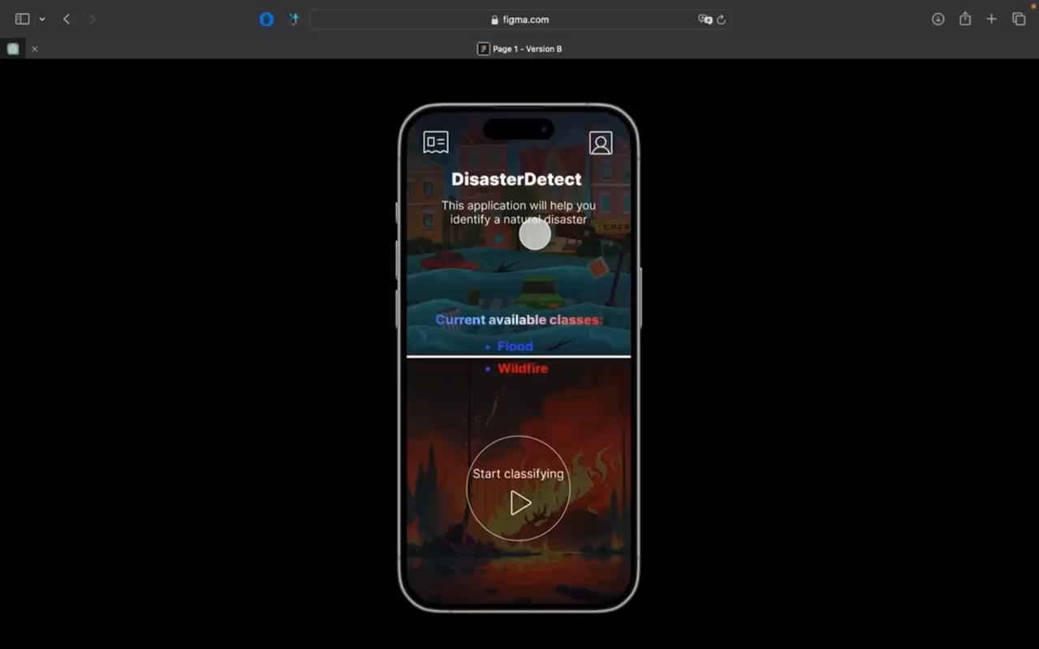
Demo
Human-Centered AI
Show your final demo video and, if necessary, explain it.
Time Limit: 2 minute

Slide 9
Thank you!
Any questions?

